Slide 1
Category Review Sauces, Dressings and Condiments

Slide 2
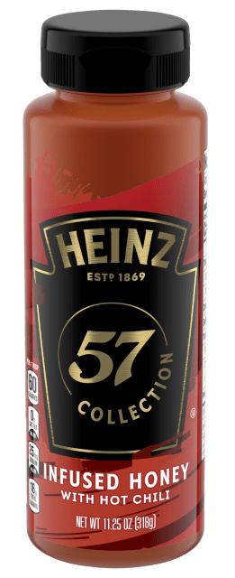
One Big Thing
There were 108 new made with honey sauces introduced in 2021.
This was a 6% increase from 2020
Honey introductions outpaced new sauce introductions
Why it matters: As consumers seek to recreate restaurant-style meals at home, they are turning to sauces, dressings and condiments to elevate ordinary meals.

Slide 3
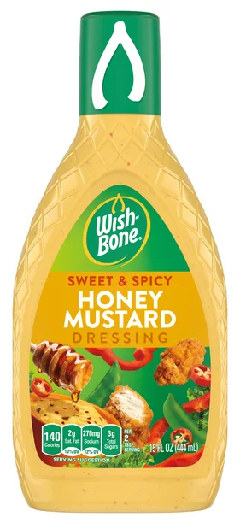
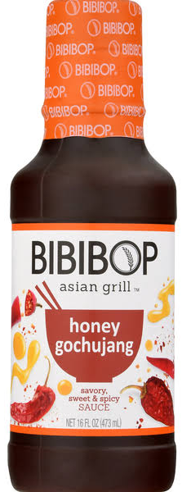
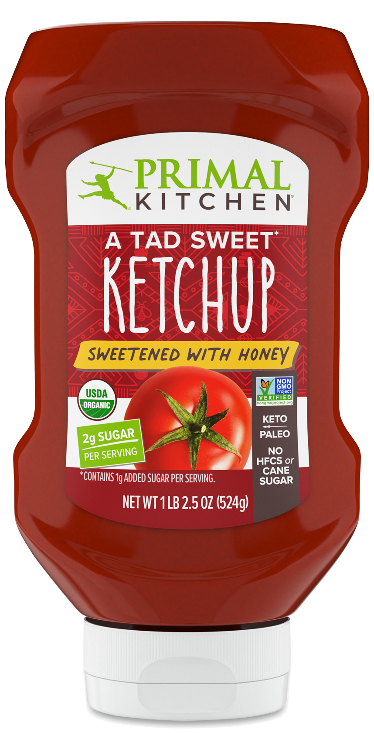
What’s Trending?
Sweet and Spicy
Global Flavors
All-Natural Sweeteners

Slide 4
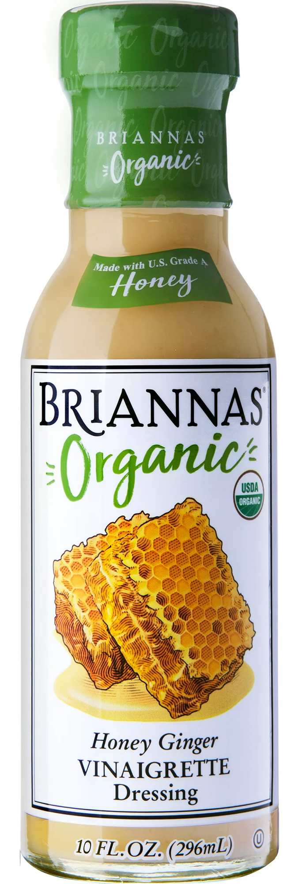
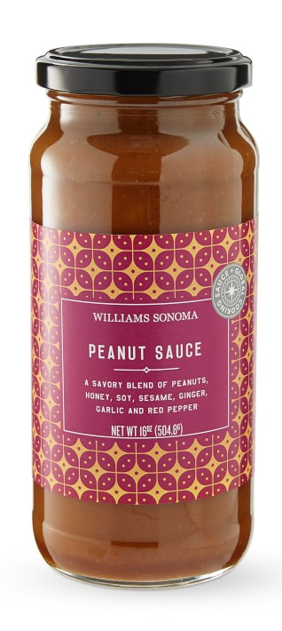
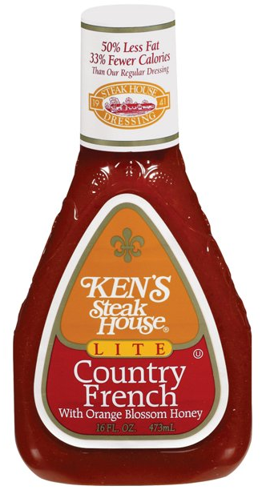
Why Honey?
Sweetener criticism and complex ingredient listings have caused the sauce aisle to consider honey.
Familiar flavor that pairs well with both spicy components and global flavors.
Marketing benefits.

Slide 5
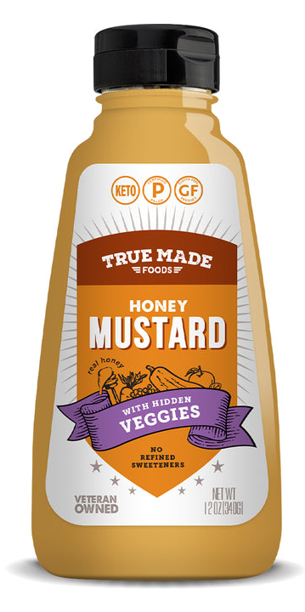
Functional Advantages
Honey has emulsification properties and may be able to reduce added ingredients.
Honey’s acidity adds complexity to sauces, and can act as a pH buffer, eliminating the need for additional acids to ensure food safety and stability.

Slide 6
Email questions to keith@honey.com

