Slide 1
Tech Talk: The Functional Reasons to Use Honey

Slide 2
acidity

Slide 3
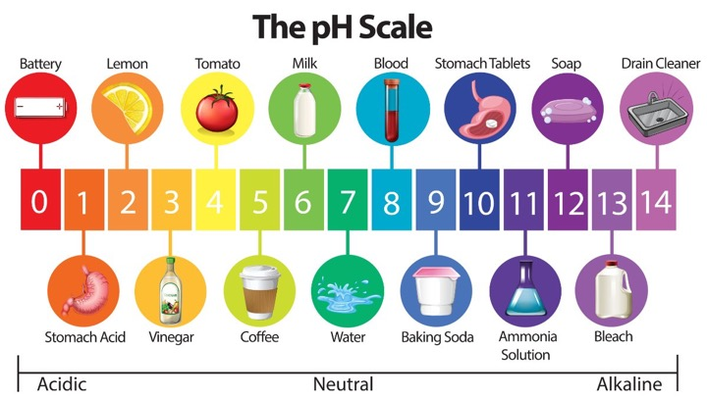
ACID 101
Notes:
Sucrose hydrolysis by invertase

Slide 4
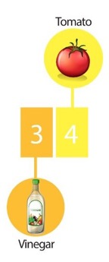
ACID 101
Honey has a pH of 3.9
The acid content in honey account for less than 0.5 percent of the solids, but its contribution to flavor is immeasurable.
The acidity also is partly responsible for the stability of honey against microorganisms.
Notes:
Sucrose hydrolysis by invertase

Slide 5


Gluconic Acid
From IPAs to Salad Dressings
Flavor-enhancing acid that complements spices, herbs and hops.
Makes other flavors taste more vibrant.
The acidity of gluconic acid enhances the perception of sweetness in foods, which makes them more enjoyable!
Acts as a flavor enhancer by improving the stability and shelf life of certain products.
Used in combination with other acids and flavor enhancers to create complex flavor profiles in food and beverages.
Naturally produced in sourdough breads and other fermented foods like kefir and yogurt.
Notes:
Gluconic acid is a type of organic acid that is produced by the oxidation of glucose by the enzyme glucose oxidase. Glucose oxidase is produced by the bees and is found in their salivary glands, where it mixes with the nectar to begin the process of converting it into honey.
During this process, glucose oxidase catalyzes the conversion of glucose to gluconic acid and hydrogen peroxide. Gluconic acid gives honey its characteristic acidic taste and also has antibacterial properties that help to preserve honey.
In addition to its role in the production of honey, gluconic acid has a variety of other uses. It is commonly used in the food industry as a flavor enhancer, acidulant, and preservative. It is also used in the production of various other products, including detergents, adhesives, and pharmaceuticals.
Gluconic acid is generally recognized as safe (GRAS) by the U.S. Food and Drug Administration (FDA) and is considered non-toxic and non-irritating. However, it can cause skin and eye irritation in concentrated forms.
Overall, gluconic acid plays an important role in the production and preservation of honey, and is also used in a variety of other applications in the food, industrial, and pharmaceutical sectors.

Slide 6
moisture retention

Slide 7
Honey keeps foods moist
Honey is a humectant. A hygroscopic substance that prevents moisture transfer. By design, it does not give up water easily and, in fact, collects moisture from the atmosphere.
This is a significant advantage over the use of dry sweeteners, especially in bakery foods.

Slide 8
mold inhibition

Slide 9
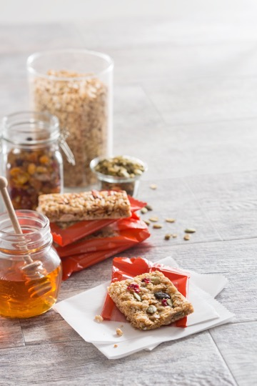
Honey inhibits mold growth
Honey’s low pH and hydrogen peroxide component inhibits numerous strains of bacteria growth.
Honey has a high concentration of sugars, which reduces water activity (0.55) and the growth of bacteria.

Slide 10
thickener and binder

Slide 11
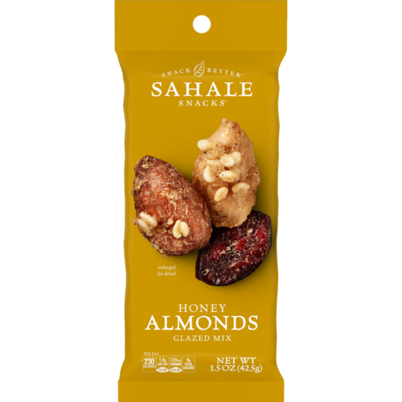
Honey naturally coats, binds and thickens sauces, bakery foods, dairy products and more.
Improves body and mouthfeel of products due to its viscosity.
Can serve as an all-natural binder in products with significant inclusions.
Can coat nuts and seeds to extend shelf life, naturally.
Notes:
How they are made

Slide 12
emulsification

Slide 13
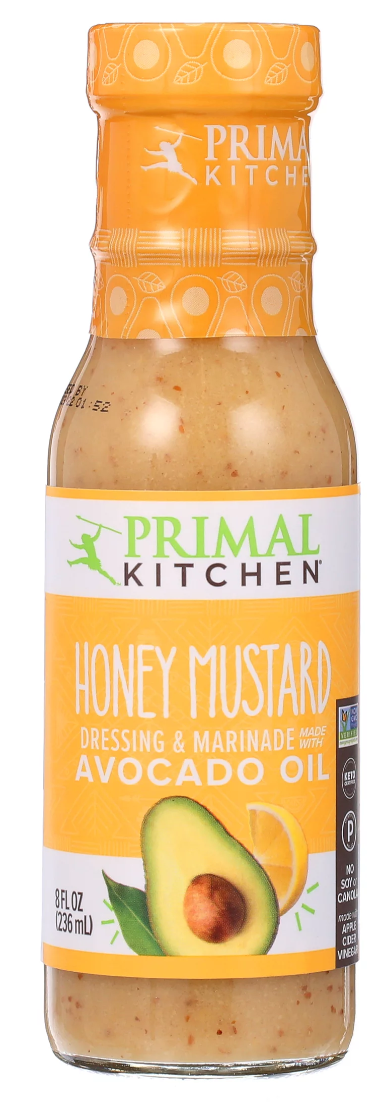
Honey may eliminate emulsifiers
Honey has emulsification properties and can be used for flavor and functionality, thus reducing number of ingredients.
Clean label emulsification.

Slide 14
masking

Slide 15
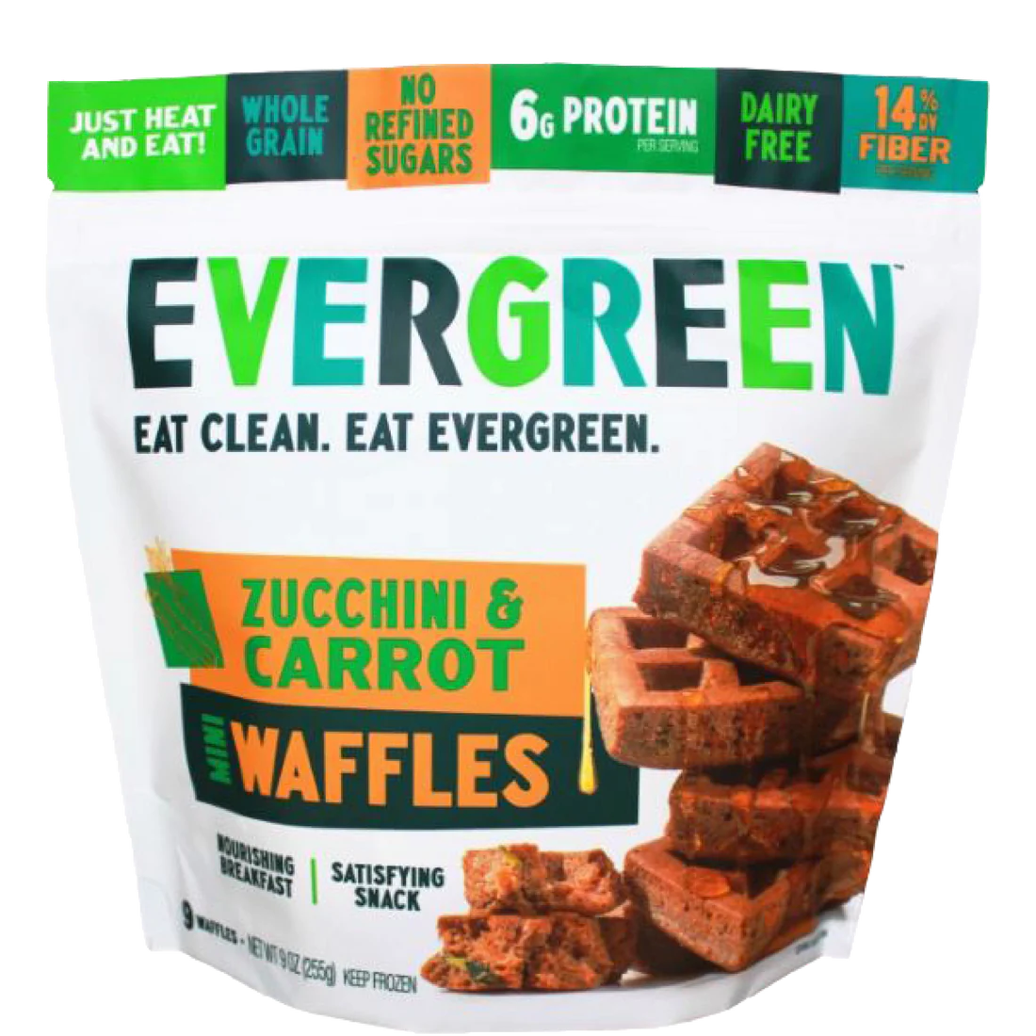
Honey is a great flavor masker.
Covers up off-flavors without over-powering a formula.
Plays key role in making whole grains and functional ingredients more palatable.
Also gives consumers comfort of a familiar flavor.

Slide 16
Email questions to keith@honey.com

